Slide 1
Resume
A paper that contains professional summary

Slide 2
11-Times New Roman-Justify
What should be the font size in resume ?
PDF
What should be the file format ?
No, It is not IITGN Document
Should we add IITGN Logo ?
First Name – IITGN – Name of the Position – Resume
What should be the resume file name ?
No, Because each organization may have different requirements. Show them How & Why you are a perfect fit.
Should we use single resume for all companies ?
Achievements, Position of Responsibility, Skill Summary, Relevant Courses, Extra-Curricular Activities.
What are the things that we should change for each company ?
A statement that shows that you have used your time efficiently.
What should we put in year gap duration ?
Which you(or your friends) are proud of
What type of achievements should we put ?
One Page
How many page resume is ideal ?
No, You are not looking for a life partner.
Should we add photo, weight, height etc ?

Slide 3
What to add in Resume
Personal Details
Education
Projects
Internships
Achievements
Position of Responsibility
Extra Curricular Activities
Skill Summary
Relevant Courses

Slide 4
“I can type without looking at thekeyboard”

Slide 5
A candidate listed his e-mail address 2: chintu143@*****.com

Slide 6
Typos and grammatical errors
It shows that
You can not write effectively
or
You do not care/your approach is casual

Slide 7
Lack of specifics
Working in HR Team as ABC at XYZ Ltd
Recruited, hired, trained and supervised more than 20 employees in an organization with $2 million in annual sales.

Slide 8
Highlight accomplishments ( not routine )
Attended group meetings and recorded minutes
Used laptop computer to record weekly meeting minutes and compiled them in a Microsoft Word-based file for future organizational reference.

Slide 9
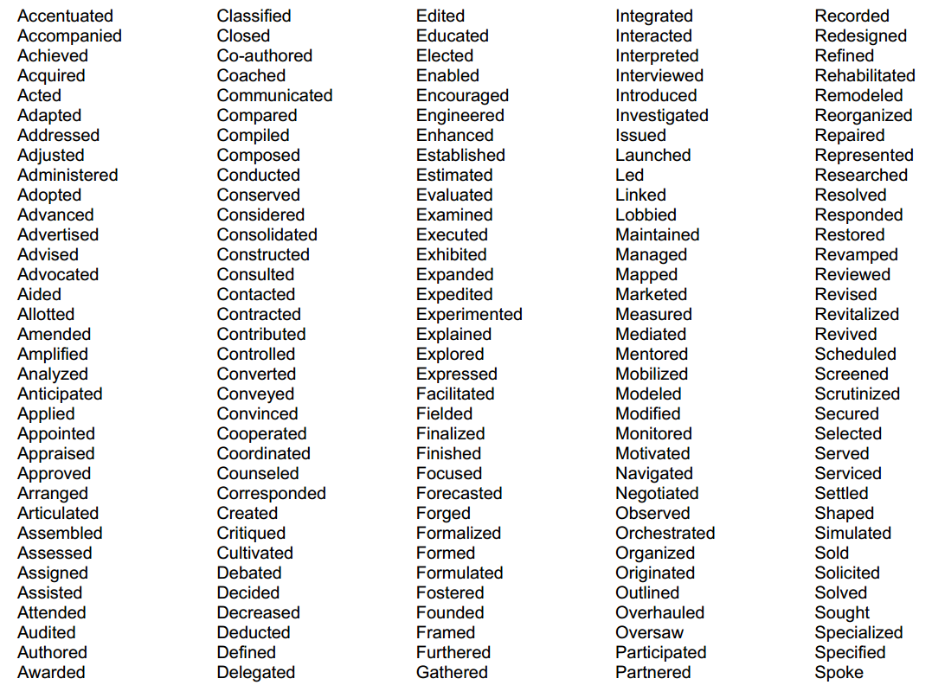
Action verbs

Slide 10
Employer wants Someone who can
Retain existing customers
Solve a problem
Make money
Expand the business
Save money
Be more competitive
Save time
Build relationships
Make work easier and more efficient
Attract new customers

Slide 11
Some Qualities they look for
Common Sense ( which is uncommon )
Effective Intelligence
Reasoning Ability
Power of Expression
Self Confidence
Determination
Organizing Ability
Initiative
Cooperation
Sense of Responsibility
Speed of Decision

